Slide 1
Office 365 Development
July 2014

Slide 2
Course Agenda
Introduction to Office 365 Development
Module 1: Deep Dive Apps for Office in Outlook
Module 2: Deep Dive Apps for Office in Word
Module 3: Deep Dive Apps for Office in PowerPoint
Module 4: Deep Dive Apps for Office in Excel
Module 5: Deep Dive into SharePoint Hosted Apps
Module 6: Deep Dive into Provider Hosted Apps
Module 7: Deep Dive into Security and OAuth
Module 8: App Lifecycle Management

Slide 3
Deep Dive into SharePoint-Hosted Apps
Speaker
Speaker

Slide 4

Agenda
Introduction
Programming in JavaScript
App Parts
UI Custom Actions

Slide 5
Introduction

Slide 6

Architecture
Azure Web Sites
Host Web
SharePoint 2013
Web Services
App Web
Notes:
App Web is a sub web under the host web
App web is a separate domain
App web is created during app installation process
App web contains pages and other declarative SharePoint artifacts
App web is limited to JavaScript
App web can access host web as long as it has appropriate permissions
May call to other cross-domain resources using appropriate techniques such as cross-origin resource sharing (CORS) or a web proxy

Slide 7
The App Web
App Web is isolated in its own domain
Enforces “Same Origin” policy for the app
Allows for authentication and authorization when calls are made to the host web
Each app has it’s own unique URL
Tenancy – your organization’s tenancy
App Unique Identifier – unique generated identifier for the app instance
Hosting Domain – defined for each farm
App Name – contained in the app manifest
https://[tenancy]-[appuid].[hostingdomain]/[appname]
Notes:
Each app web is isolated in a unique domain

Slide 8
App Start Page
Specified in App Manifest
~appWebUrl/Pages/Default.aspx?{StandardTokens}
Utilizes Tokens for dynamic replacement of parameters
~appWebUrl token representing the URL for the app web of this app instance
{StandardTokens} passes key query string parameters to the app on launch
Parameter | Description
SPHostUrl | The URL of the host web
SPAppWebUrl | The URL of the app web
SPLanguage | The language/culture of the host web
SPClientTag | The client cache control number for the current website
SPProductNumber | The full build version number of the SharePoint farm
Notes:
{StandardTokens} combines five other tokens. It initially resolves to SPHostUrl={HostUrl}&SPAppWebUrl={AppWebUrl}&SPLanguage={Language}&SPClientTag={ClientTag}&SPProductNumber={ProductNumber}. Then each of these tokens resolves. If there is no app web, the portion &SPAppWebUrl={AppWebUrl} is not present.

Slide 9
App Permissions
Utilizes “Internal” Authentication
App permissions are the lesser of user and app permissions to the given resource

Slide 10
App Shapes
Full Page
Required for all apps
Experienced when an app is launched from the contents page
App Part
Optional
Allows an app to be hosted in an IFrame on the host web
UI Custom Action
Optional
Allows an app to be launched from the ribbon or Edit Control Block(ECB)

Slide 11
Creating SharePoint-Hosted Apps
Pages
ASPX
HTML
Authorization
Internal
Programmability
JavaScript REST or CSOM
JavaScript Cross-Domain Library
Web Proxy
Notes:
SharePoint-Hosted apps can be built on ASPX or HTML pages
The authorization is always done with “Internal” auth, meaning no OAuth tokens
Programmability is always JavaScript
You can use CSOM, REST, cross-domain library, or web proxy in your solution

Slide 12
demo
Creating a SharePoint-Hosted App

Slide 13
Programming in JavaScript

Slide 14
Using the REST API

Slide 15
Using the CSOM API

Slide 16
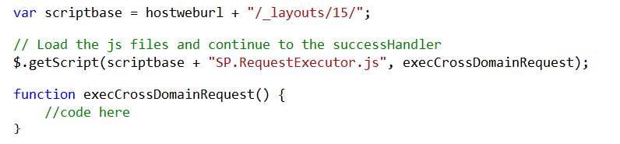
Cross Domain Library
Same-domain policy prevents JavaScript from making direct calls to the host web
SP.RequestExecutor.js located in LAYOUTS directory
Option 1: Reference directly
Option 2: Load dynamically
Notes:
Makes it possible to call the host web from JavaScript in the app web

Slide 17
Cross-Domain Library Architecture
Web Page
IFRAME
App Web
AppWebProxy.aspx
SP.RequestExecutor.js
AppWebProxy.aspx
Remote Web
SharePoint
Notes:
The remote web loads the SPRequestExecutor.js library
The remote web create a new SP.RequestExecutor object, initializing it with the URL of the app web
This causes a hidden IFRAME to be created, which loads APPWebProxy.aspx from the LAYOUTS directory
The SP.RequestExecutor object uses the HTML5 postmessage command to send requests from the remote web
The request is executed by the AppWebProxy.aspx page
The response is returned

Slide 18
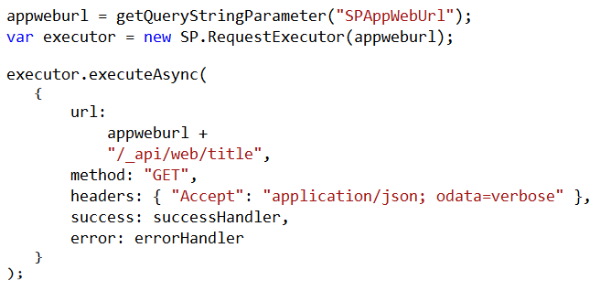
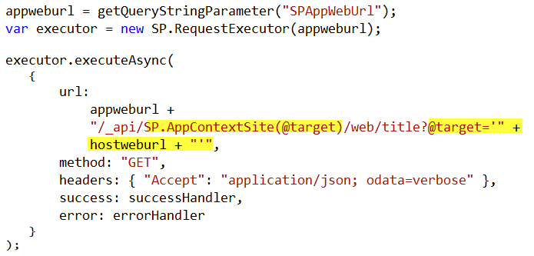
Cross-Domain REST Calls
Call targeting App Web
Call targeting Host Web
Notes:
When calling the host web, you must switch the context

Slide 19
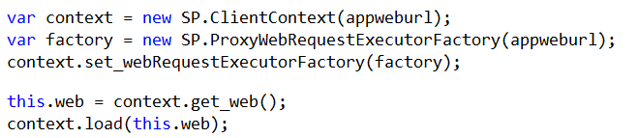
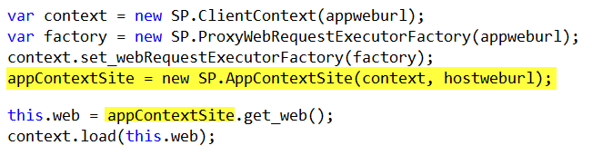
Cross-Domain CSOM Calls
Call targeting App Web
Call targeting Host Web
Notes:
When calling the host web, you must switch the context

Slide 20
demo
The Cross-Domain Library

Slide 21
The Chrome Control

Slide 22
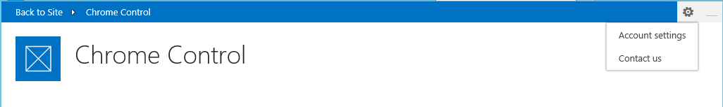
Chrome Control
JavaScript Component for creating basic banner and navigation elements
Notes:
When you create a remote web, it’s nice to have it borrow some of the characteristics of the host web
This way, it doesn’t surprise the user by changing the UI drastically

Slide 23
Loading the Chrome Control
SP.UI.Controls.js located in LAYOUTS directory
Option 1: Copy and include directly in your app
Option 2: Load Dynamically using jQuery

Slide 24
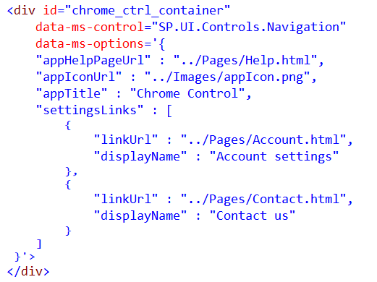
Chrome Control (Declaratively)
Notes:
Create a div tag
Use the attributes data-ms-control and data-ms-options
The chrome control will look for these attributes and render itself in this div

Slide 25
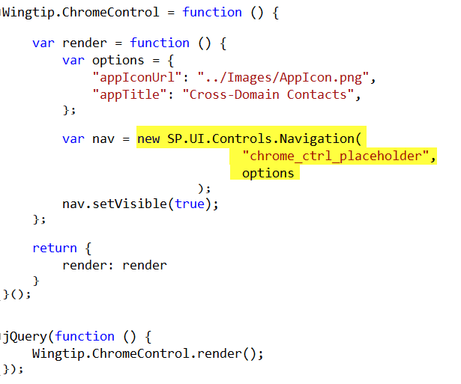
Chrome Control (Programmatically)
Notes:
Here a new chrome control is created in code
When created, it expects you to supply the options and the ID of the div where it should render
Then it renders itself in the div

Slide 26
demo
The Chrome Control

Slide 27
Remote Event Receivers

Slide 28
Remote Event Handlers
Event Handler code runs in remote web
Deployed as web service in remote web
Two-way events
“Before” events (a.k.a, “ING” events)
Synchronous call
Supports a return value
One-way events
“After” events (a.k.a, “ED” events)
Asynchronous call
No return value
Notes:
The event handler infrastructure follows the same pattern as the in-process handlers of old
We have both “before” and “after” event
These are also known as “ING” and “ED” events like “ItemAdding” and “ItemAdded”
Two-way events are synchronous

Slide 29
Supported Events
 | Site | List | List Schema | List Item | App
Create | X | X | X | X
Update |  |  | X | X
Delete | X | X | X | X
Move | X |  |  | X
Check-In |  |  |  | X
Uncheck-In |  |  |  | X
Check-out |  |  |  | X
Attachments |  |  |  | X
File Move/Convert |  |  |  | X
Install |  |  |  |  | X
Uninstall |  |  |  |  | X
Update |  |  |  |  | X

Slide 30
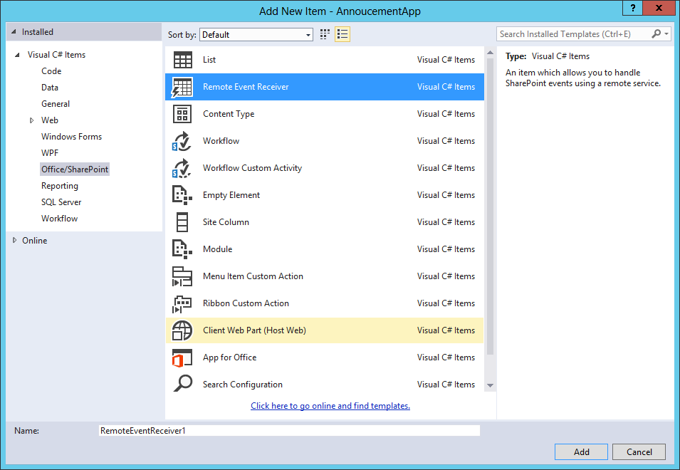
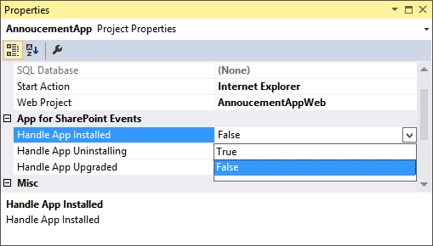
Adding a Remote Event Receiver
Use the “Add New” dialog
For Site, List, Item, and
Schema events
Use the “Properties” dialog
for App events

Slide 31
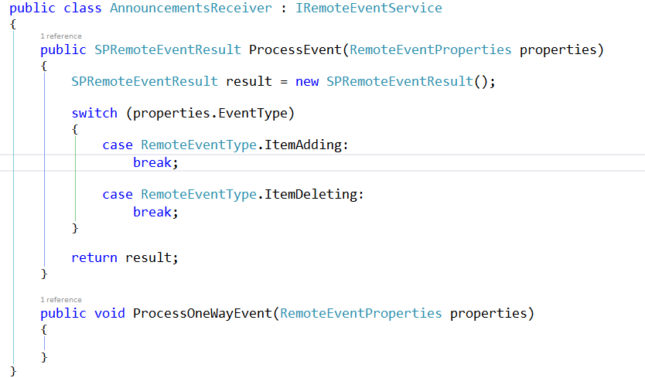
IRemoteEventService
Must be implemented by the remote web service

Slide 32
SPRemoteEventProperties
Passed to web service in response to event
Provides contextual information
Supports reading and updating user inputs
Allows for data validation

Slide 33
SPRemoteEventResult
Returns by two-way events
Allows events to be cancelled
Allows status to be returned

Slide 34
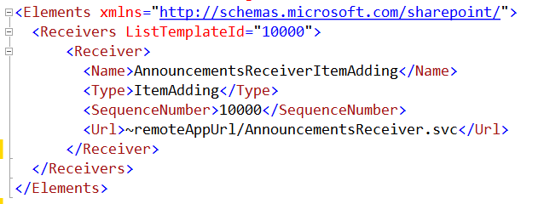
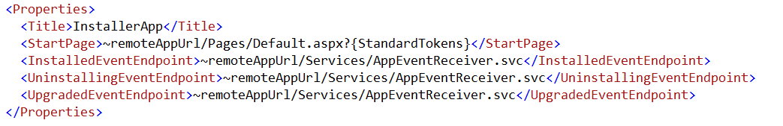
Registering Events Receivers
CAML Element for Lists, Items, Sites, Schema events
App Manifest for
App events

Slide 35
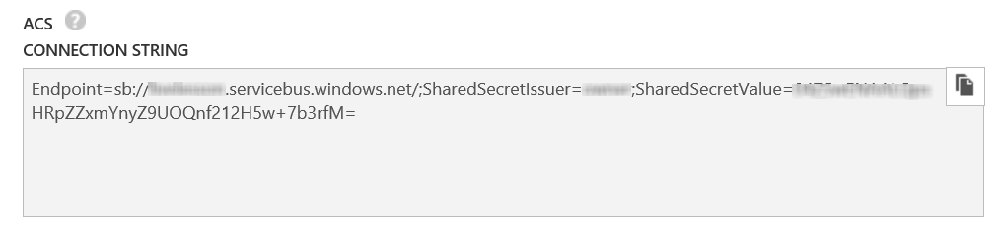
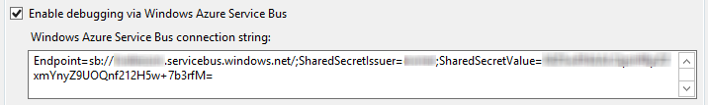
Debugging Considerations
Remote Event Receivers require Azure Service Bus to support debugging
Create a Service Bus Namespace
Copy the Connection String into the SharePoint Project Properties

Slide 36
demo
Remote Event Receivers

Slide 37
Summary
Introduction
Programming in JavaScript
App Parts
UI Custom Actions

Slide 38

© 2012 Microsoft Corporation. All rights reserved. Microsoft, Windows, and other product names are or may be registered trademarks and/or trademarks in the U.S. and/or other countries.
The information herein is for informational purposes only and represents the current view of Microsoft Corporation as of the date of this presentation. Because Microsoft must respond to changing market conditions, it should not be interpreted to be a commitment on the part of Microsoft, and Microsoft cannot guarantee the accuracy of any information provided after the date of this presentation. MICROSOFT MAKES NO WARRANTIES, EXPRESS, IMPLIED OR STATUTORY, AS TO THE INFORMATION IN THIS PRESENTATION.

